Slide 1
Team Feedback
Semantic Kernel Hackathon

Slide 2
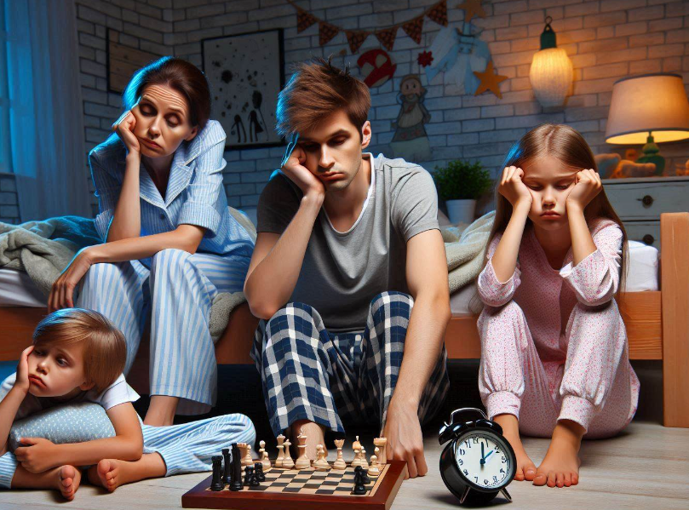
Empathize
Ideate
Its Bedtime!
Parents are tired after a long day at work.
The kids are not ready for bed. They can't sleep until they have a bedtime story.
Define
Prototype
Test
Empathize
Once Upon AI Time

Slide 3
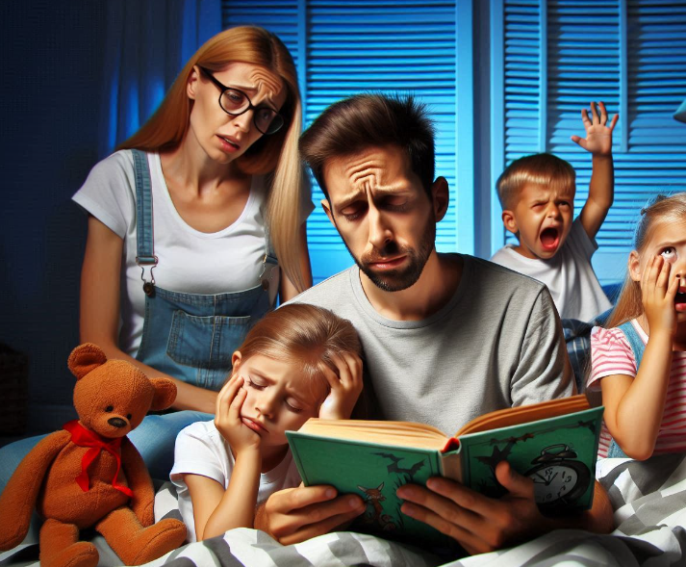

The problem
Empathize
Ideate
Define
Define
Prototype
Test
Our problem statement:
Children are difficult to settle at bedtime and need an engaging story.
Children want unique stories about specific topics, or often involving themselves
Not every parent is a talented storyteller (or just wants a glass of wine and to go to bed themselves)

Slide 4
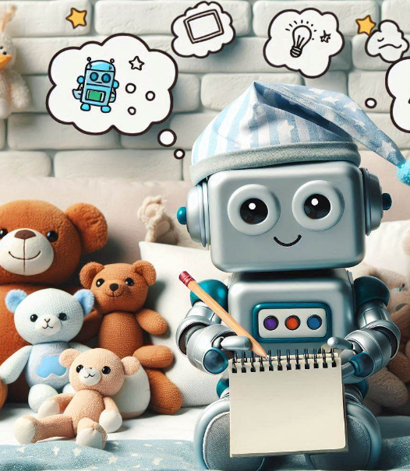
The solution
Ideate
Solutions we considered:
Providing an AI that tells a bedtime story
Personalizing the bedtime story using prompts
Using a location API to provide specific references
Creating generated images from the story
Enabling the story to be read aloud by a voice AI
Empathize
Ideate
Define
Prototype
Test

Slide 5

The demo
Prototype
Prototype
We created a bedtime storyteller that writes a bedtime story, uses your favourite location and reads it aloud.
Once Upon AI Time

